Slide 1
現代制御理論を用いた核融合プラズマ制御シミュレーション
三善 悠矢
東京大学大学院新領域創成科学研究科

Slide 2
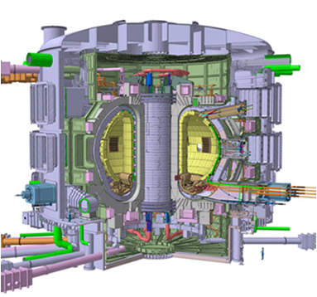
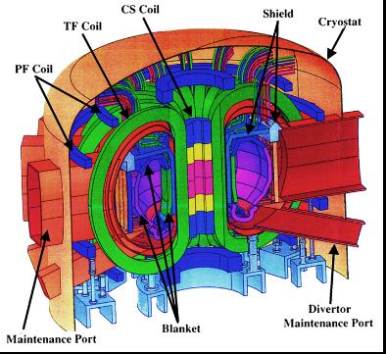
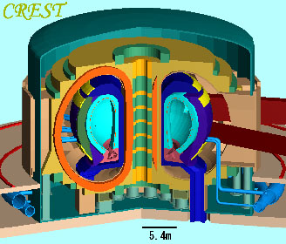
Introduction
Commercial [2]
ITER [1]
DEMO [2]
Under construction
Construction of control system is needed.
Construction of control system for high performance plasma with limited actuators or diagnostics is needed.

Slide 3
Control Logic Construction
①
Control parameters
②
③
actuators and diagnostics
Control logic
Control System construction

Slide 4
Example of Parameter Categorization
Item | Control parameter | mid parameter | measurable parameter
Electrical output | Pfus | ne,Z ,f ,f , Ti,Te
Safety operation | q ,W | qra ,q ,n τ,Zeff ,f
Plasma stability | β , n ,qmin, rotation | Ip,ap ,j(r),Bt
Plasma shape, position | R ,ap,κ,δ,d | Ip,j(r)
eff
D
T
rad
elm
edg
div
load
eff
imp
N
GW
min
p
p
p
gap
Detailed discussion is needed.

Slide 5
Example of Actuator Categorization
 | gas-puff | pellet | NBI | RF | coil
ne | ○ | ○ | △
Zeff | ○ | ○
fd,fT,fimp | ○ | ○ | △
Ti |  |  | ○
Te |  |  | ○ | ○
qrad | ○ | ○
qelm |  | ○ |  |  | ○
Ip |  |  | ○ | ○ | ○
j(r) |  |  | △ | ○ | △
Rp,ap |  |  |  |  | ○
κ,δ |  |  |  |  | ○
dgap |  |  |  |  | ○
rotation |  |  | ○
For multiple control, Coupling effect must be taken into account.

Slide 6
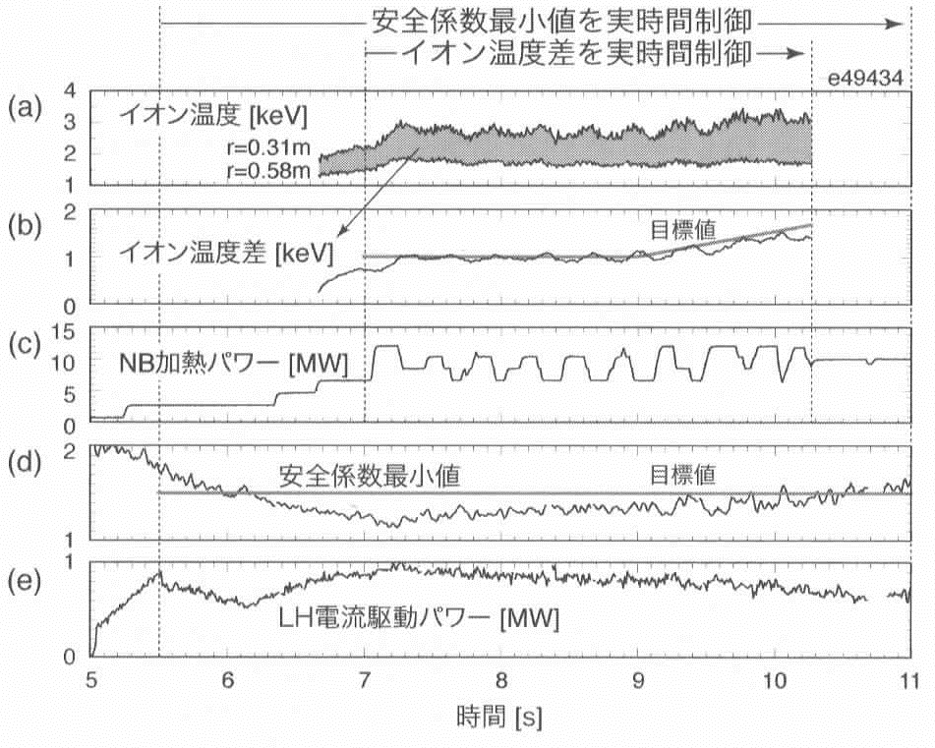
Multiple Control Experiment
JT-60 experiment
LHCD
qmin
current profile
NBI
ITG
pressure gradient
q-minimum real time control
ΔTi real time control
Ti
Ref
Difference in Ti
NBI power
q-minimum
Ref
LHCD power
Time
[3]T.Suzuki, J.Plasma Fusion Res. Vol86, No9 530-535 (2010) (in Japanese)

Slide 7
1.5D transport code simulation
JT-60 experiment
LHCD
qmin
current profile
NBI
pressure gradient
ITG
transport code simulation [4]
gas-puff
Fusion power
NBI
minimum q-value

Slide 8
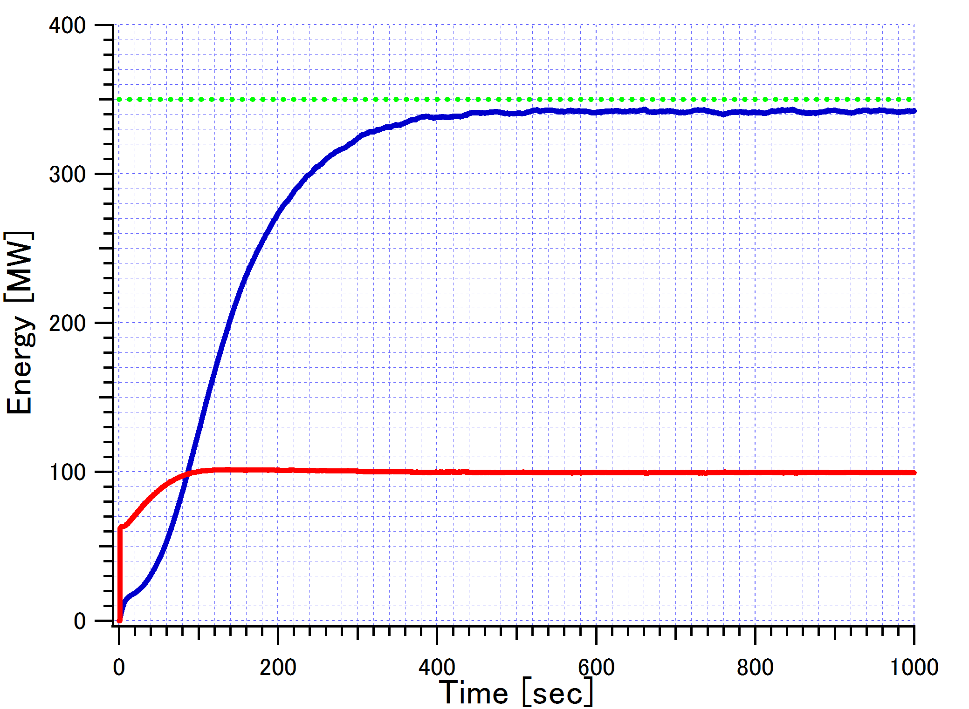
Fusion power control simulation
Target value
Gas-puff [10^19/sec]
Fusion power
Gas-puff
Current profile movie
Density profile movie

Slide 9
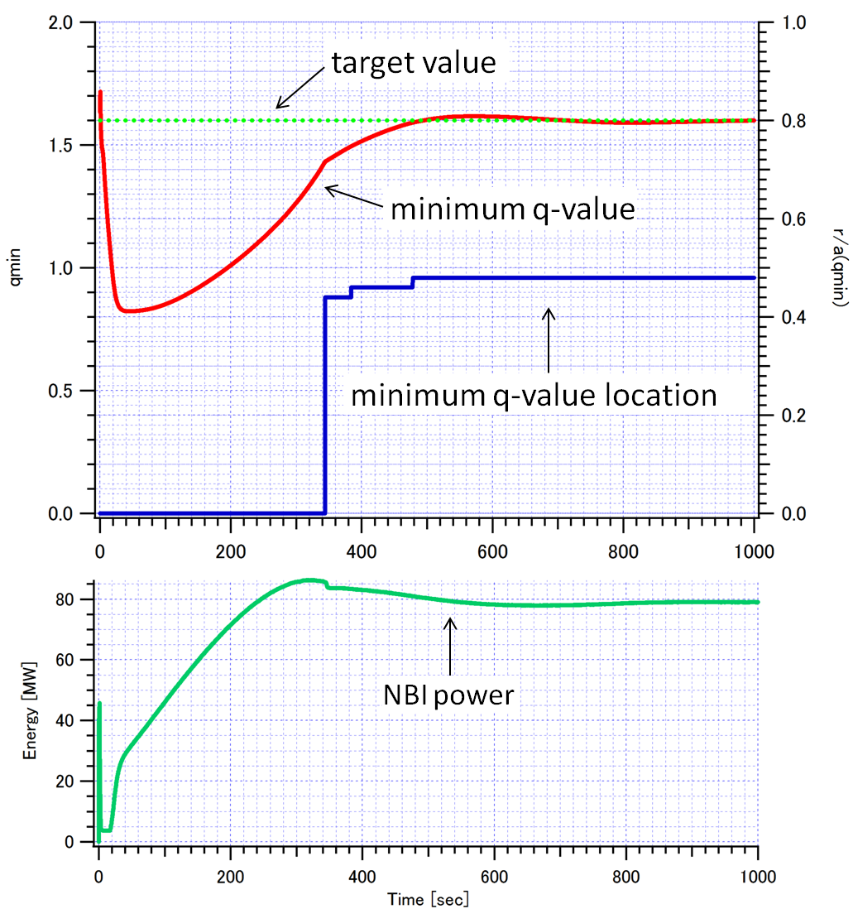
q-minimum control simulation
q-min
r/a (q-min)
Energy [MW]
Current profile

Slide 10
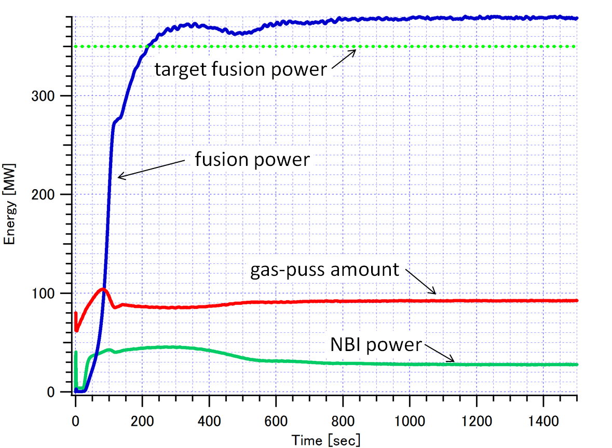
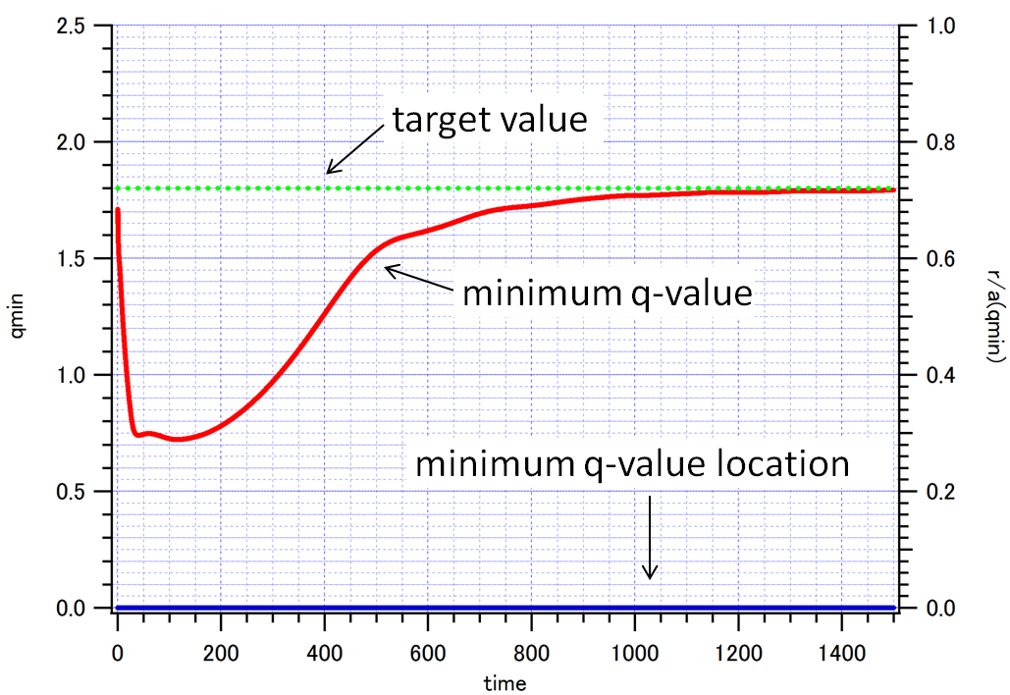
Simultaneous control simulation
Energy [MW]
Gas-puff [10^19/sec]
q-min
r/a (q-min)

Slide 11
Summary of 1.5D simulation
Single Control
gas-puff
Fusion power
Easy to control
Single Control
NBI
minimum q-value
Simultaneous Control
Difficult to control because of their interaction
gas-puff
Fusion power
NBI
minimum q-value
It is difficult to determine the appropriate gain matrix from only the response characteristics.

Slide 12
Using modern control theory
Classical control
Modern control
0-D analysis
This research
1.5-D analysis
Simultaneous control simulation
Plasma Experiment
JT-60 experiment

Slide 13
Classical and Modern control theory
Classical control
True system
r
＋
e
Control
u
Black Box
y
－
True system
Modern control
Model difference
r
＋
e
Control
u
Physical Model
y
－
Managed as disturbance

Slide 14
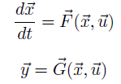
State space model
To determine actuator value, we use this ‘State space model’
state vector
actuator vector
Control requirement
output vector
We can get appropriate actuator value u.

Slide 15
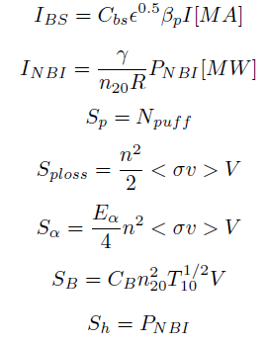
0-D Plasma Physics Model
a=2 (m), R=6.2 (m)
0.7

Slide 16
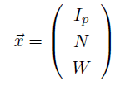
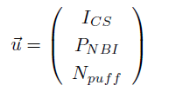
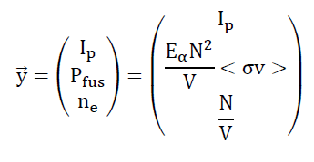
State Equation
State vector
From
Actuator vector
Output vector
we get
x
and
u

Slide 17
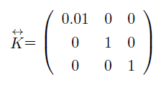
Linearized State Equation
ne
P control

Slide 18
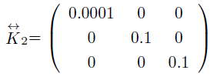
Adding the Integrator
Add the integral term to avoid the disturbance.
PI control

Slide 19
2 degree of freedom control
Find the equilibrium point from the reference and physical model
Feed forward Control
ueq
r
＋
e
Δu
u
y
Feedback Control
Plasma
－
Find the feed back gain from physical model

Slide 20
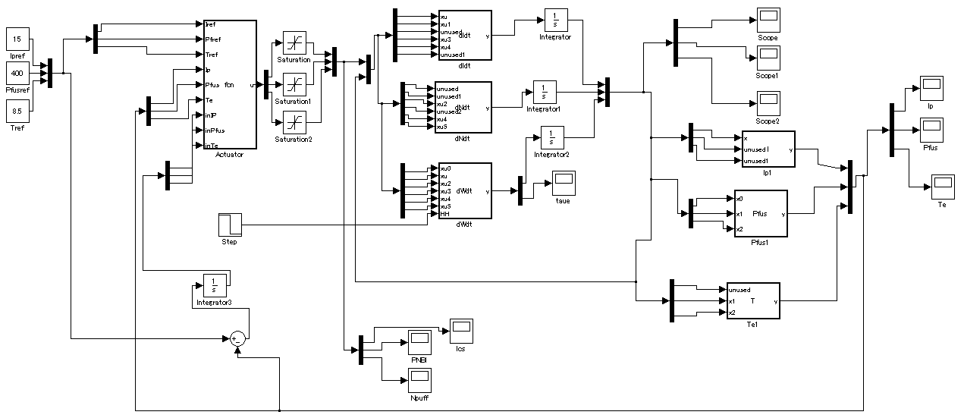
Simulink
We use the software ‘MATLAB/Simulink’ to do simulation.
MATLAB/Simulink

Slide 21
Summary
・
For control logic construction, categorizing of control parameters, actuators and diagnostics is necessarily.
・
In this research, we determine the PI gain from 0-D plasma physics model, and we demonstrate the 0-D control simulation.
・
The simulation using a transport code or plasma control experiment are future work.

Slide 22
Reference
[1] http://www.naka.jaea.go.jp/ITER/iter/index.html
[2] http://www.asahi-net.or.jp/~rt6k-okn/subject.htm
[3] 3]T.Suzuki, J.Plasma Fusion Res. Vol86, No9 530-535 (2010) (in Japanese)
[4] Y. Miyoshi et.al PFR Vol.7 2405135 (2012)
[5] Control system design (G. C. Goodwin et.al)

Slide 23
Appendix

Slide 24
The Effect of Disturbance
True system
Model err
r
＋
e
Control
u
Nominal Model
y
－
d
If controller has integrator (1/s), the effect of step disturbance will vanish.

Slide 25
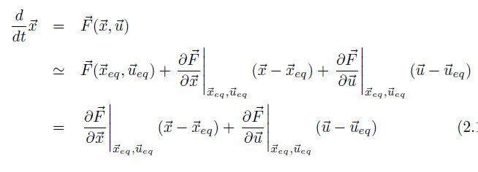
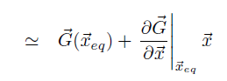
Linearize
In this simulation, we assume that equation point = reference point.

