Slide 1
第16回 若手科学者によるプラズマ研究会
2013/03/04-06 @Naka, JAEA
Development of Multi-Layer 1D divertor code and analysis of detached divertor plasmas
ªSatoshi Togo, ^{b}Makoto Nakamura, ^{c}Katsuhiro Shimizu,
^{d}Tomonori Takizuka, ^{b}Kazuo Hoshino, ªYuichi Ogawa
ªGraduate School of Frontier Science, University of Tokyo
^{b}Japan Atomic Energy Agency, Aomori
^{c}Japan Atomic Energy Agency, Ibaraki
^{d}Graduate School of Engineering, Osaka University

Slide 2
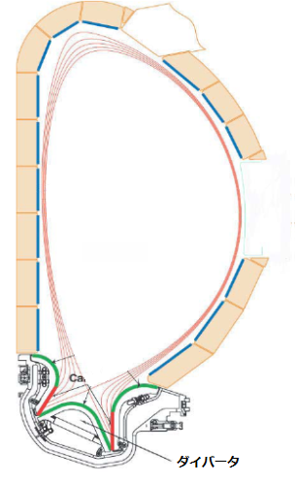
Back ground
Divertor heat load
Reduction of the divertor heat load is one of the crucial issues for commercializing the fusion reactors.
The divertor heat load have to be 5~6MW/m² at most from the material point of view.
Core
Plasma
P_{out}
P_{out} ～ 90MW
(ITER)
P_{out} ～ 500MW
(Slim-CS)
The wetted area is a few square meters so some sort of power handling is necessary.

Slide 3
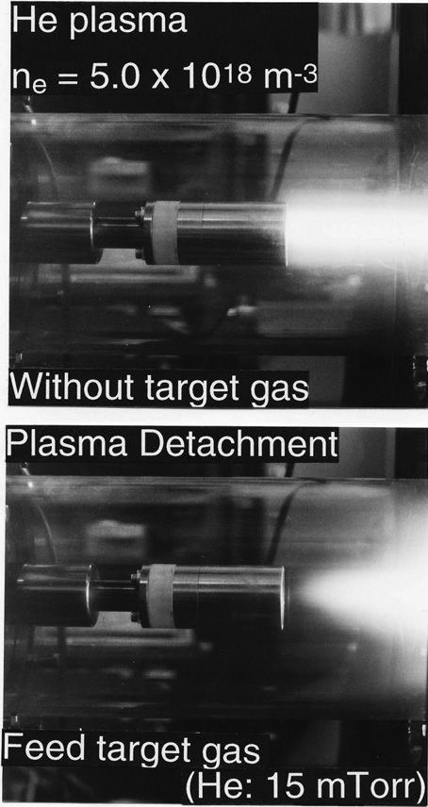
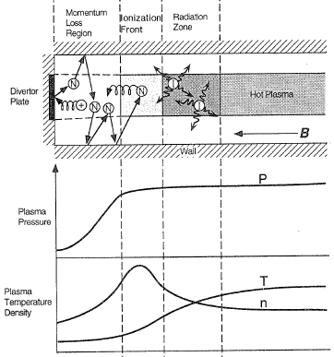
Back ground
Divertor detachment
S. Takamura, J. Plasma Fusion Res. 72, No.9, 866-873 (1996).
Divertor detachment is thought to be a promising way.
N. Ohno and S. Takamura, J. Plasma Fusion Res. 84, No.11, 740-749 (2008).

Slide 4
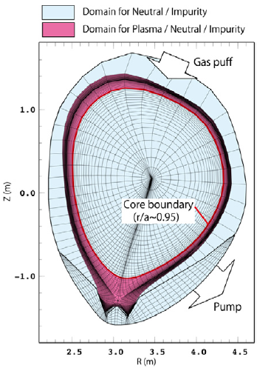
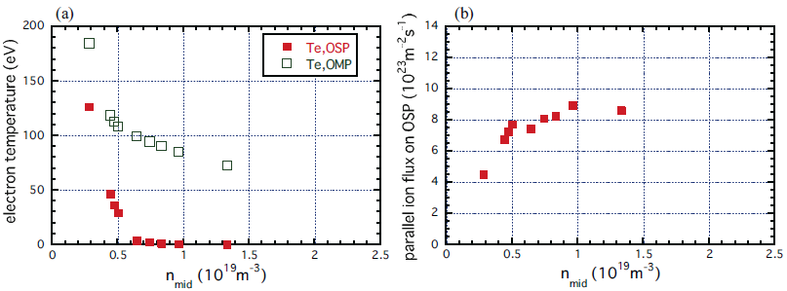
Back ground
Two-dimensional SOL-divertor code
2D codes are used in order to estimate rigorously the performance of the divertor.
In simulating detached divertor regime, there are some quantitative disagreements with the experimental results.
Numerical grid for JT-60U in the SONIC simulation
The electron temperature and the parallel ion flux as a function of the mid-plane density
K. Hoshino et al., J. Plasma Fusion Res. Ser. 9, 592-597 (2010).

Slide 5
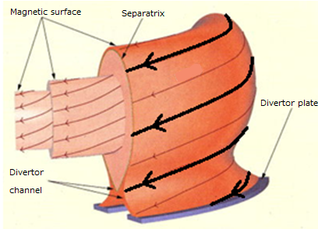
Purpose of our research
We have been developing Multi-Layer (ML) 1D divertor code so as to generate an understanding of the important processes for the quantitative reproduce of (partially) detached divertor plasmas.
http://www.lhd.nifs.ac.jp/
Attached
Tube
The characteristics of partially detached divertor plasmas in the perpendicular direction are reproduced with only two flux tubes.
Detached
Tube
Core
Plasma
0
Magnetic Field
X-point
L
x
Schematic picture of ML 1D code

Slide 6
ML 1D code
Basic equations
Mass conservation:
Attached
Tube
Detached
Tube
Core
Plasma
Momentum conservation:
0
Magnetic Field
X-point
L
x
Radial transport is included in the source terms.
Energy conservation:
Density, velocity and temperature of ion and electron are assumed to be equal, respectively.

Slide 7
ML 1D code
Source terms/Atomic processes
Particle source:
Momentum source:
Energy source:
S. Takamura, J. Plasma Fusion Res. 72, No.9, 866-873 (1996).

Slide 8
ML 1D code
Boundary condition
x=0
Stagnation point (x = 0)
Divertor plate (x = L)
x=L
Attached
Tube
Detached
Tube
Core
Plasma
is the sheath heat transmission factor.
0
Magnetic Field
X-point
L
x

Slide 9
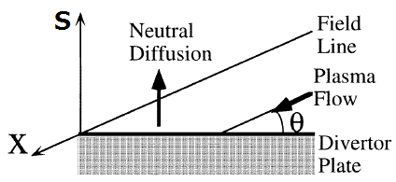
ML 1D code
Neutral model
Particle conservation：
Convection with Franck-Condon Energy
Diffusion by charge exchange reaction
Radial transport
Neutralization rate
Boundary condition：
S. Nakazawa et al., Plasma Phys. Control. Fusion 42, 401-413 (2000).

Slide 10
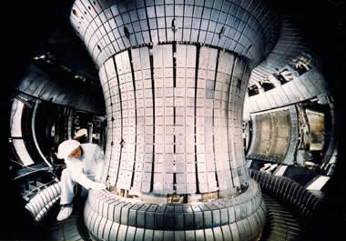
ML 1D code
Calculation condition
Simulation has been done for ASDEX-Upgrade like plasma.
A. Kallenbach et al., Nucl. Fusion 48 085008 (2008).
・Major radius R：1.7m
・Minor radius a：0.6m
・Surface safety factor q：3.3
・Connection length πqR：17.6m
・Divertor leg：4.4m
・Area of separatrix：40m²
・Width of the SOL：2cm
http://www.ipp.mpg.de/ippcms/eng/for/projekte/asdex/
・Heat flux from the core plasma：4MW
・Neutralization rate of the plate η：99%
・Impurity：Carbon, 1%, non-coronal equilibrium

Slide 11
Recent result
Attached plasma solution
[/m³]
X-point
[eV]
Diffusion by the charge exchange is assumed to be dominant.
[/m³]
Particle flux from the core plasma is 1.0×10²¹ s⁻¹.

Slide 12
Recent result
Attached plasma solution
[W]
Heat loss is too small to dissipate all of the heat flux from the core so that the temperature near the plate is relatively high.
Heat flux
Core
Imp.
CX
Ioniz.
At such temperature, volume recombination can’t dominate ionization so that detachment doesn’t occur.
Recomb.
Ionization
499×10²⁰/s
[/s]
Particle flux
Core
5×10²⁰/s
ION
NEUTRAL
Core
Ioniz.
Recomb.
Neutralization
504×10²⁰/s
Recycled
499×10²⁰/s
Not recycled
5×10²⁰/s

Slide 13
Recent result
Detached plasma solution
X-point
[/m³]
[eV]
If radial neutral loss is large enough, τ_{n}~10⁻⁴ s, particle balance is accomplished and steady state solutions appear.
[/m³]
The gradient of the neutral density profile near the plate is negative implying neutral flows toward the plate there.

Slide 14
Recent result
Detached plasma solution
[W]
Core
Heat loss is large enough to dissipate all of the heat flux from the core so that the temperature near the plate is relatively low.
Imp.
CX
Ioniz.
The temperature is low enough for volume recombination to dominate ionization so that detachment occurs.
Recomb.
Heat flux
[/s]
Ionization
6.2×10²²/s
Core
2.5×10²²/s
Radial loss
2.5×10²²/s
Core
Ioniz.
ION
NEUTRAL
Recomb.
Particle flux
Recombination
8.7×10²²/s

Slide 15
Conclusion
・ML 1D divertor code has been developed. During the last year, numerical neutral model was introduced and numerical scheme was improved. The detached regime has been successfully reproduced.
・Heat and particle balance in both attached and detached regime have been investigated indicating that the difference in the particle balance between attached and detached regime might be related to the formation of partially detached divertor plasma.
・To distinguish the mechanism of neutral transport by means of their generation is our future work.

