Slide 1
SOL-divertor plasma simulations with virtual divertor model
Satoshi Togo, Tomonori Takizukaª, Makoto Nakamura^{b},
Kazuo Hoshino^{b}, Yuichi Ogawa
Graduate School of Frontier Sciences, University of Tokyo, 5-1-5 Kashiwanoha, Kashiwa 277-8568, Japan
ªGraduate school of Engineering, Osaka University, 2-1 Yamadaoka, Suita 565-0871, Japan
^{b}Japan Atomic Energy Agency, 2-166 Omotedate, Obuchi, Rokkasho, Aomori 039-3212, Japan
2014/03/06 Thu @那珂核融合研究所
第17回若手科学者によるプラズマ研究会

Slide 2
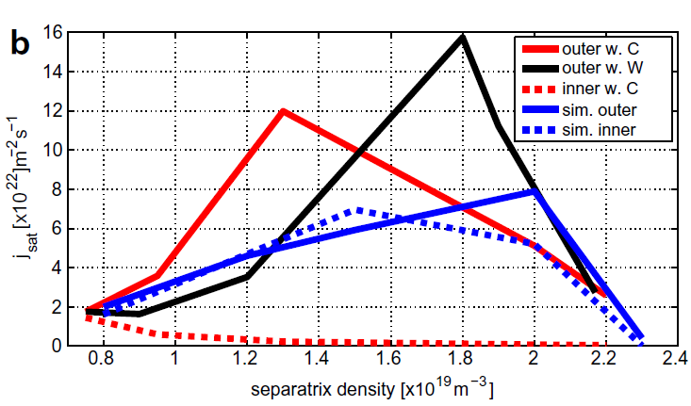
Motivation
Edge transport code packages, such as SOLPS and SONIC, are widely used to predict performance of the scrape-off layer (SOL) and divertor of ITER and DEMO. Simulation results, however, have not satisfactorily agreed with experimental ones.
Comparison of results (EXP vs SIM)
M. Wischmeier et al., J. Nucl. Mater. 390-391, 250 (2009).

Slide 3
Introduction of anisotropic temperature
As the first step to resolve this issue, we improve a one-dimensional SOL-divertor code by introducing the anisotropic temperature, T// and T⊥, into the fluid modeling.
In an open field system of SOL-divertor plasma, the convective loss of parallel component of the energy is larger than that of perpendicular component, and T// becomes lower than T⊥.
Convective loss of energy
Parallel component:
Perpendicular component:

Slide 4
Parallel viscosity term
Introduction of the anisotropic temperature makes it possible to exclude the viscosity term, which results from the temperature anisotropy, in the parallel momentum equation.
For isotropic temperature, the viscosity term is approximated by a second-derivative term;
 | anisotropic temperature | isotropic temperature
momentum conservation
energy conservation
relaxation

Slide 5
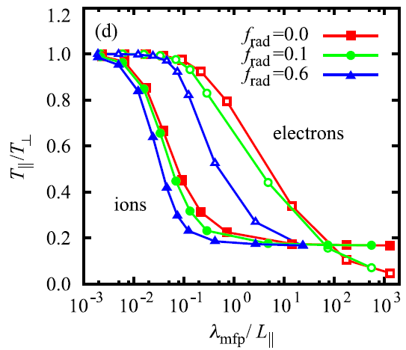
Anisotropy of ion temperature can be large
Kinetic simulations of SOL-divertor plasmas using particle-in-cell model combined with Monte-Carlo binary collision model showed the remarkable anisotropy in the ion temperature even for the medium collisional regime.
Result using particle simulation code
A. Froese et al., Plasma Fusion Res. 5 026 (2010).

Slide 6
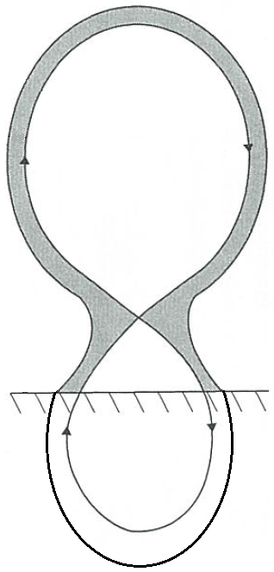
Exclusion of Bohm condition
The momentum equation with the second-derivative viscosity term requires one more boundary condition. SOL-divertor plasma codes existing usually adopt the Bohm condition M = 1 (M is Mach number) at the sheath entrance in front of the target plate, while the rigorous Bohm condition only imposes the lower limit of M (≧1).
When the viscosity term is excluded, the plasma flow can be determined only by the upstream condition.
M = 1

Slide 7
Virtual divertor model
In order to express the sheath effect implicitly, we are developing a “virtual divertor model”. The virtual divertor has an artificial sink of particle, momentum and energy.
We have introduced ion particle conservation, parallel plasma momentum conservation and plasma energy conservation (T_{i}=T_{e}=T), and successfully obtained the supersonic flow at the target.
virtual divertor region

Slide 8
Geometry of 1D code
particle & heat
Plasma surface area is assumed to be 40 m².
Periodic boundary condition is adopted (stagnation point is not fixed).
Particle and heat flux from the core plasma is assumed to be uniform along the SOL region.
virtual divertor region

Slide 9
Basic equations for plasma
particle & heat
conservation of ion particles
S includes S_{core}
conservation of parallel plasma momentum
Parallel viscosity is excluded.
conservation of plasma energy
Q includes Q_{core} and Q_{rad}
flux limiter is used.

Slide 10
Basic equations for virtual divertor
particle & heat
conservation of ion particles
: input parameters
conservation of parallel plasma momentum
artificial viscosity term
sheath effect
conservation of plasma energy
linearly interpolated using the values at the plates

Slide 11
Discretization
discretization scheme
general conservation equation
full implicit
upwind
central
staggered mesh (uniform dx)

Slide 12
Calculation method
matrix equation
(ex. N = 5)
Matrix G becomes cyclic tridiagonal due to the periodic boundary conditon. This matrix can be decomposed by defining two vectors u and v so that
where A is tridiagonal.

Slide 13
Calculation method
Sherman-Morrison formula
where and . y and z can be solved by using tridiagonal matrix algorithm (TDMA).
calculation flow
No
Energy
Momentum
Particle
P = 2nT
Yes
Yes
No
The number of equations can be changed easily.

Slide 14
Sample calculation
particle
Plasma temperature (uniform) | 50 eV
Particle flux (symmetric) | 6.0×10²¹ /s
Time constant of artificial sink (unifrom) | 10⁻⁵ s
Coefficient of artificial viscosity (uniform) | 10⁻⁵ Pa・s
Mesh width | 10 cm
Time step | 10⁻⁷ s
No
Energy
Momentum
Particle
P = 2nT
Yes
Yes
No

Slide 15
Result of sample calculation
Time evolution of density profile
Time evolution of Mach number profile
Calculation of the time evolutions of density profile and Mach number profile has been successfully done. Calculation time is about 40 sec (LHD numerical analysis server).

Slide 16
Comparison with analytical solution
Density profiles
Mach number profiles
X-point
X-point
Calculated profiles are well agreed with analytical one in the SOL region but not well in the divertor region.
Supersonic flow may be attributed to numerical viscosity caused by upwind difference.

Slide 17
Continuity of Mach number
conservation of ion particles
conservation of parallel plasma momentum
O. Marchuk and M. Z. Tokar, J. Comput. Phys. 227, 1597 (2007).
Due to the continuity of Mach number, RHS has to be zero at the sonic transition point (M = 1).
RHS > 0
RHS ≦ 0
Sonic transition has to occur at the X-point. If there is no temperature gradient, supersonic flow does not occur.

Slide 18
Coupling with energy equation
particle & heat
Particle flux (symmetric) | 6.0×10²¹ /s
Heat flux (symmetric) | 0.2 MW
Time constant of artificial sink (unifrom) | 10⁻⁵ s
Coefficient of artificial viscosity (uniform) | 10⁻⁵ Pa・s
Cooling index (uniform) | 3
Mesh width | 10 cm
Time step | 10⁻⁷ s

Slide 19
Result of calculation (coupling)
Time evolution of temperature profile
Coupling with the equation of energy has been successfully done. Calculation time is about 3 min (LHD numerical analysis server).

Slide 20
Result of calculation (coupling)
Time evolution of density profile
Time evolution of Mach number profile
Mach number at the target becomes larger (supersonic) because of the temperature gradient.

Slide 21
Dependence on the cooling index α
particle & heat
Particle flux (symmetric) | 6.0×10²¹ /s
Heat flux (symmetric) | 0.2 MW
Time constant of artificial sink (unifrom) | 10⁻⁵ s
Coefficient of artificial viscosity (uniform) | 10⁻⁵ Pa・s
Cooling index (uniform) | 1-6
Mesh width | 10 cm
Time step | 10⁻⁷ s

Slide 22
Result of calculation (α)
Dependence of temperature profile on α
Correlation between γ and α
Profile of temperature (and other physical values) and sheath transmission factor γ change in accordance with α but saturates at α = 3 because of the heat flux limiter. γ cannot be excluded as a boundary condition.

Slide 23
Result of calculation (α)
Dependence of density profile on α
Dependence of Mach number profile on α

Slide 24
Effect of the radiation cooling
particle & heat
rad.
Particle flux (symmetric) | 6.0×10²¹ /s
Heat flux (symmetric) | 0.2 MW
Radiation flux (symmetric, uniform) | 0.1 MW
Time constant of artificial sink (unifrom) | 10⁻⁵ s
Coefficient of artificial viscosity (uniform) | 10⁻⁵ Pa・s
Cooling index (uniform) | 3
Mesh width | 10 cm
Time step | 10⁻⁷ s

Slide 25
Result of calculation (radiation)
Time evolution of temperature profile
Temperature gradient becomes large due to the radiation cooling. γ ~ 20.3.

Slide 26
Result of calculation (radiation)
Time evolution of density profile
Time evolution of Mach number profile
Mach number at the target becomes larger (supersonic) because of the larger temperature gradient.

Slide 27
Effect of the asymmetric particle source
particle & heat
3.6×10²¹ /s
2.4×10²¹ /s
Particle flux (asymmetric) | 6.0×10²¹ /s
Heat flux (symmetric) | 0.2 MW
Time constant of artificial sink (unifrom) | 10⁻⁵ s
Coefficient of artificial viscosity (uniform) | 10⁻⁵ Pa・s
Cooling index (uniform) | 3
Mesh width | 10 cm
Time step | 10⁻⁷ s

Slide 28
Result of calculation (asymmetric)
Time evolution of temperature profile
γ ~ 11.3 (little asymmetric).

Slide 29
Result of calculation (asymmetric)
Time evolution of density profile
Time evolution of Mach number profile
The position of the stagnation point moves.

Slide 30
Summary & conclusion
1D SOL-divertor plasma simulation code with virtual divertor model has been developed. Virtual divertor has an artificial sink of particle, momentum and energy implicitly expressing the effect of the sheath.
Solutions meeting the Bohm condition have been obtained in various calculations. Numerical viscosity caused by upwind difference makes the flow supersonic even if there is no temperature gradient.
Sheath heat transmission factor γ cannot be excluded as a boundary condition.
Calculation time which tends to be long when the non-linear equation of energy is solved has to be shorten in some way because the number of such non-linear equations becomes large hereafter.
Temperature has to be divided at least into T_{i//}, T_{i⊥} and T_{e}.

Slide 31
Support materials

Slide 32
Temperature anisotropy
T. Takizuka et al., J. Nucl. Mater. 128-129, 104 (1984).

Slide 33
Necessity of artificial viscosity term
conservation of ion particles
conservation of parallel plasma momentum
When V is positive, RHS becomes positive. If V becomes supersonic, dV/dx becomes positive and V cannot connects.

Slide 34
Effect of artificial viscosity term

Slide 35
Flux limiter

