Slide 1
LHDにおけるIRVBを用いた
プラズマ輻射計測の現状
(3次元輻射計測の開発)
Ryuichi Sano¹, Byron J. Peterson², Masaru Teranishi³, Naofumi Iwama², Masahiro Kobayashi², Kiyofumi Mukai², Shwetang N. Pandya¹
¹Graduate University for Advanced Studies, ²NIFS and ³Hiroshima Institute of Technology
若手科学者によるプラズマ研究会 2014.03.05-07

Slide 2
Motivation
DEMO or ITER →reduction of the heat flux to the divertor is important.
Plasma detachment is planned with enhanced radiation for the reduction of heat flux.
Radiation mainly occurs outside of the LCFS.
→1 dimensional assumption can not be applied.
→3D or 2D measurement is required.
IRVBs(IR imaging Video Bolometer) have many channels (500-1000ch/IRVB).
-This advantage will be effective for tomography
-In LHD and KSTAR etc.
3D radiation measurement using with tomography is planned in LHD

Slide 3
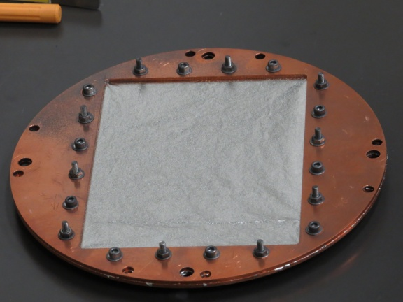
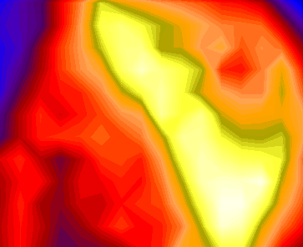
IR imaging video bolometer (IRVB)
Plasma radiation
(Far IR～soft Xray)
IR window
Heat radiation
(IR)
Plasma
IR camera
Aperture
Vacuum
vessel wall
Metal foil
Solve heat
diffusion
equation
Pt, blackened
Temperature
Radiation Image

Slide 4
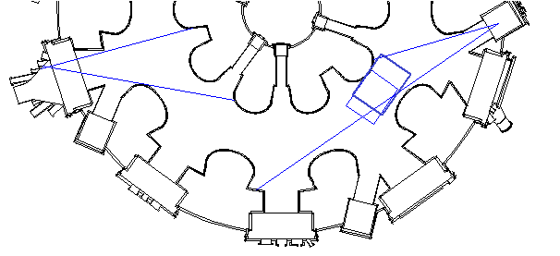
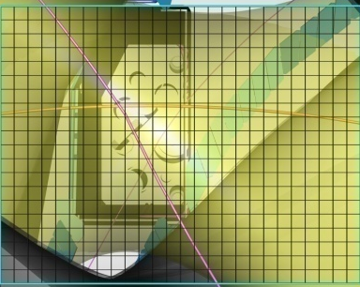
4 IRVBs are installed in LHD
10-O
6.5-L
6-T
6.5-U
6.5-L (30x22 ch)
(100 fps)
10-O(36x28 ch)
(100 fps)
6.5-U(26x20 ch)
(50 fps)
6-T(36x28 ch)
(100 fps)

Slide 5
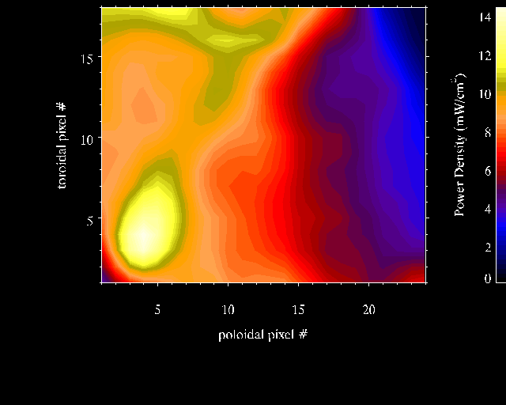
IRVBs can measure spatial and temporal radiation changes
Toroidal
Toroidal
Poloidal
Poloidal
Toroidal
Poloidal

Slide 6
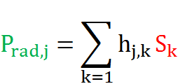
Tomography (Inverse calculation)
Measurement
3D profile
Tomography
Measured (IRVB)
Geometry matrix
P_{rad,j} :Absorbed power on each detector
h_{j,k} :The geometry matrix as a projection matrix
S_{k} :The radiation intensity from the plasma-voxel
j :Index of detector channel
k :Index of plasma-voxel

Slide 7
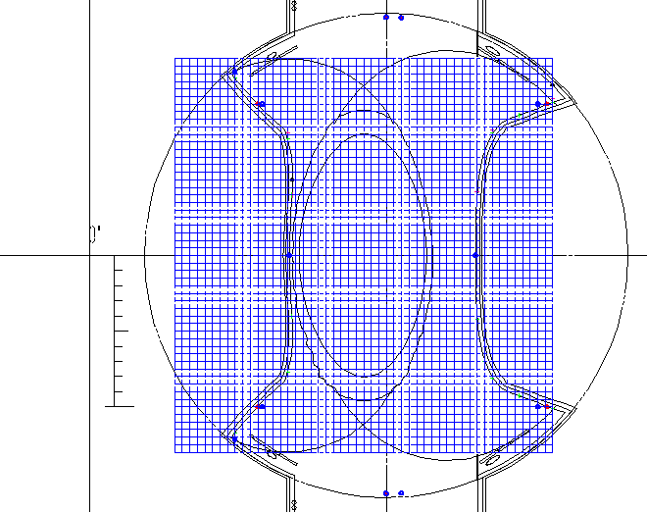
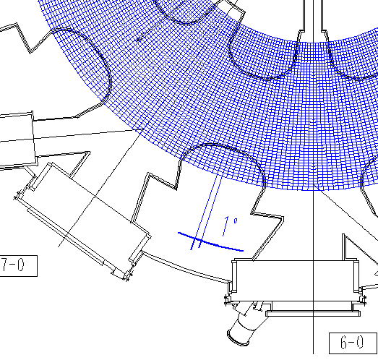
LHD plasma divided into voxels for 3D tomography
LHD plasma
Mean minor radius: 0.6m
Major radius: 3.9m
Plasma voxels:
Horizontal: 5 cm
50 divisions (2.5 m < R < 5.0 m)
Vertical : 5cm
52 divisions (-1.3 m < Z < 1.3 m)
Toroidal: 1 degree
360 divisions
Total number of plasma voxels
:50x52x360=936,000
Total number of IRVB channels
:3,196ch
IRVB channels << Plasma voxels

Slide 8
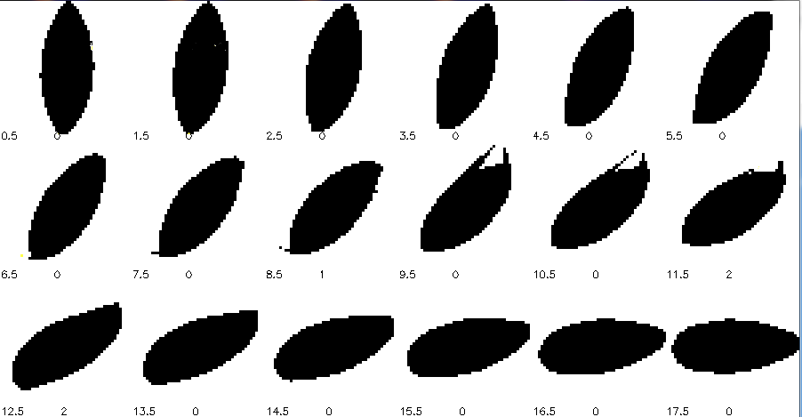
Total number of plasma voxel is reduced by mask
Non plasma voxels eliminated using EMC3-EIRENE prediction of radiating volume
936,000 → 263,220
radiation region
Non-radiation region

Slide 9
Assumption of Helical periodicity reduces number of plasma voxels
Each plasma voxel should be seen by at least one IRVB channel
Number of IRVBs is just 4
→Fields of view of IRVBs can not cover entire torus
→ Assumption of helical periodicity is employed.
S(R, φ , Z) = S(R, π/5- φ,-Z)
Helical periodicity
・The plasma repeats itself
every 18 degree toroidally.
Total number of plasma voxels reduced
:263,220/20 = 13,161
Total number of IRVB channels
:3,196 ch

Slide 10
Reconstruction by ART (Algebraic Reconstruction Techniques)
P : IRVB signal
H : Projection matrix
S : Plasma radiation at voxel
ART: Iterative method with feedback for every sight line.
H
Calculation time=(2 hours/ frame)
S
P
Iteration
H
H^{T}
S₁
P
P
S₁
S₂
H^{T}
S₂
H
P
P
S₂
S₃

Slide 11
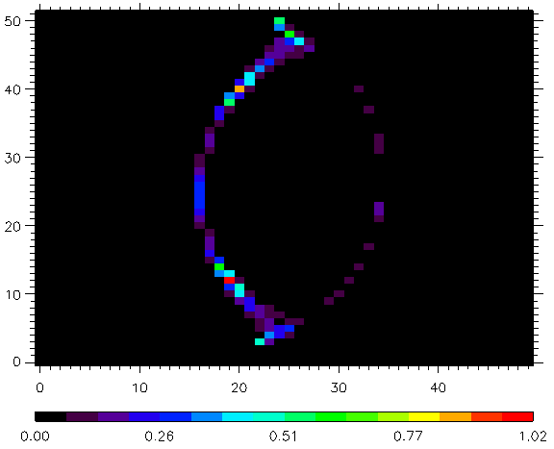
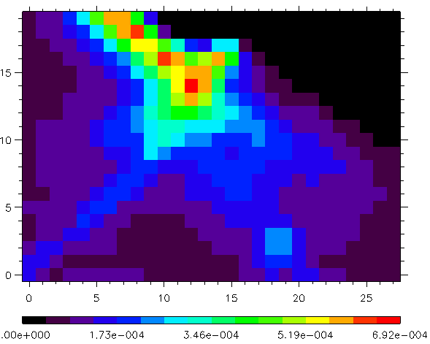
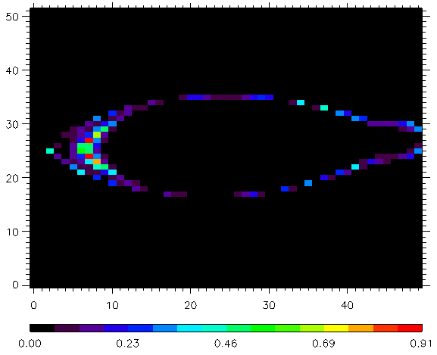
Test image reconstructed by ART (from simulated profile)
Test hollow profiles is reproduced through reconstruction
Test radiation profile, S
(calculated by EMC3-EIRENE)
Reconstructed profile, S’
Incident radiation at 6.5-L, P
(from EMC3-EIRENE)
ART

Slide 12
Reconstruction by SVD (Singular Value Decomposition)
P : IRVB signal
H : Projection matrix
S : Plasma radiation at voxel
S
S
IRVBs signal (3196)
=
=
P
H
H⁻¹
P
Plasma radiation (13,161)
SVD
U : Left singular vector of H
V: Right singular vector of H
W: Diagonal matrix of singular value
H (13161 x 3196) was successfully decomposed
H⁺: Pseudo-inverse matrix of H
(4 minutes / frame)

Slide 13
Test image reconstructed by SVD (from simulated profile)
Like ART profiles, but negative values are produced.
Test radiation profile, S
(calculated by EMC3-EIRENE)
Reconstructed profile, S’
Incident radiation at 6.5-L, P
(from EMC3-EIRENE)
SVD

Slide 14
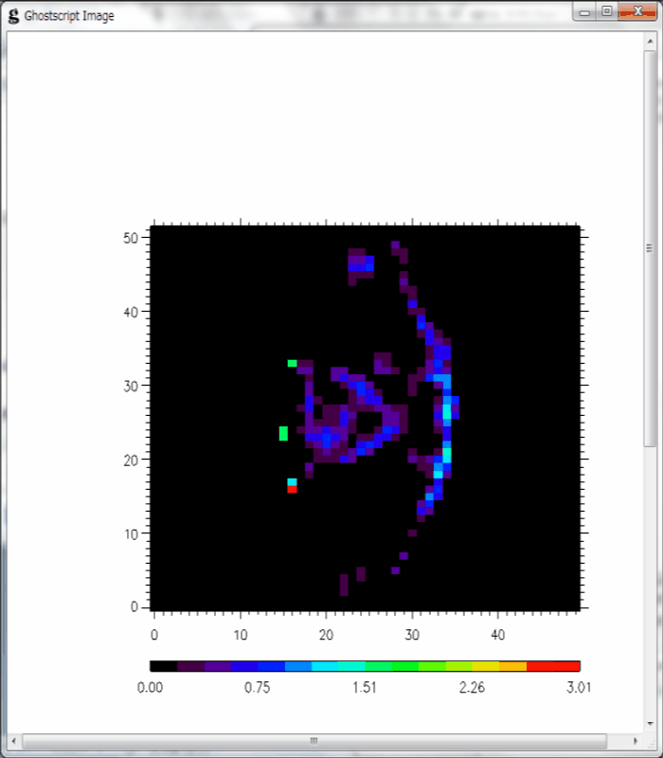
Reconstructed 3D profile from experiment (ART method)
Reconstructed 3D profile from experiment (ART method)
ART results has localized radiation at the edge plasma
Reconstructed 3D profile from experiment (SVD method)
#120930
・Radiation is localized in the edge region.
・Calculation takes 2 hours.
・There are no negative values.
・Radiation from core region may be ghosts.
#120930

Slide 15
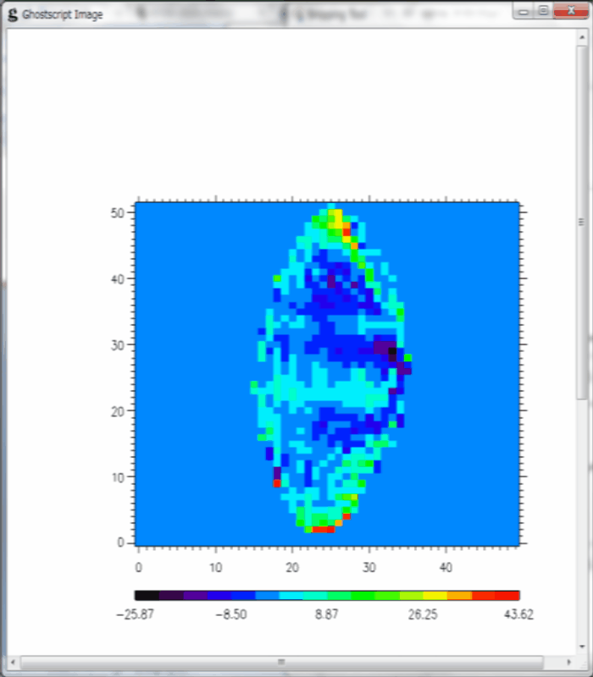
Reconstructed 3D profile from experiment (SVD method)
SVD results has strong radiation in core.
#120930
・Radiation is not localized in a certain region.
・Calculation takes 4 minutes.
・Large negative values are produced.

Slide 16
Summary
3D tomography techniques for radiation measurement using 4 IRVBs with ART and SVD are developed in LHD
・ART method
Features of test profile reproduced through reconstruction.
But minor ghosts remain in core.
ART takes 30 times more calculation time than SVD.
・SVD method
Features of test profile reproduced through reconstruction.
But strong ghosts remain in core.
Both methods need more improvement
Measurement of enhanced radiation for detachment or starting phase of radiation collapse.

Slide 19
Reconstructed (GCV is considered)
(A)
ε**2
(B)
1.91e-13
4e-16
1.9e-13
2.7e-9
(C)

Slide 20
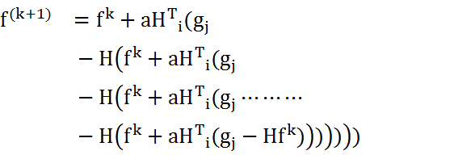
Reconstruction by ART (Algebraic Reconstruction Techniques)
P : IRVB signal
H : Projection matrix
S : Plasma radiation at voxel
ART: Iterative method with feedback for every sight line.
H: Projection matrix
a: Weight parameter for feedback
k: Counts of iterations
f: 3D radiation profiles
g: IRVB data
M: total number of IRVB channels
M (3,196) times
N=1～M
Current 3D radiation profile
H
(N)th IRVB channel
H^{T}
Original
(N)th IRVB channel

Slide 21
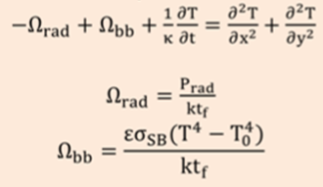
Characterization of foil thermal properties needed for calibration
IRVB measurement
Heat diffusion equation
Foil temperature
Solve Heat
diffusion equation
Radiation power
Foil parameters (not uniform)
Foil thickness : t_{f}
Emissivity : ε
Thermal diffusivity: κ
Conventional method gives only t_{f}
Developed method gives t_{f} and ε by iterative convergence
Ryuichi SANO et al., Plasma and Fusion Res. 7 2405039 (2012)

Slide 22
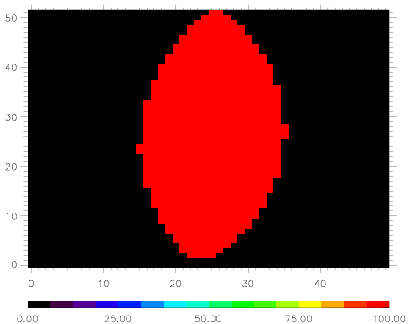
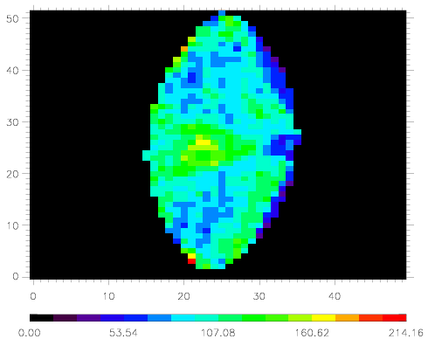
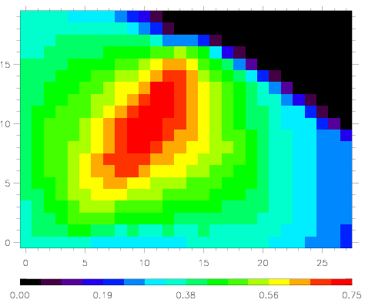
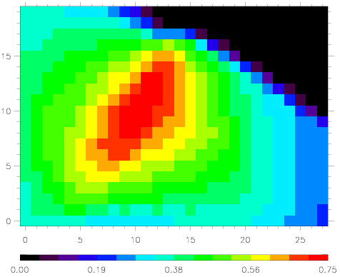
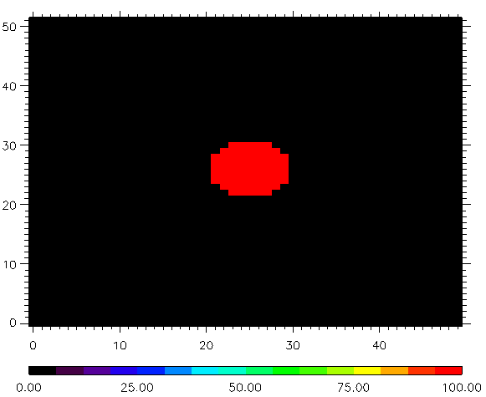
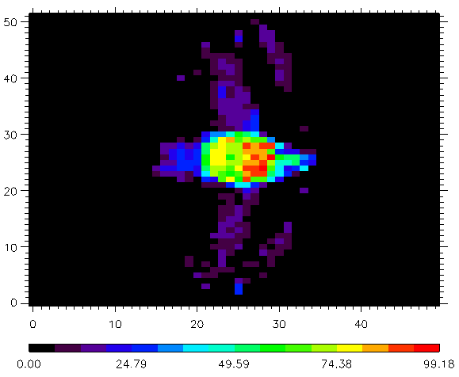
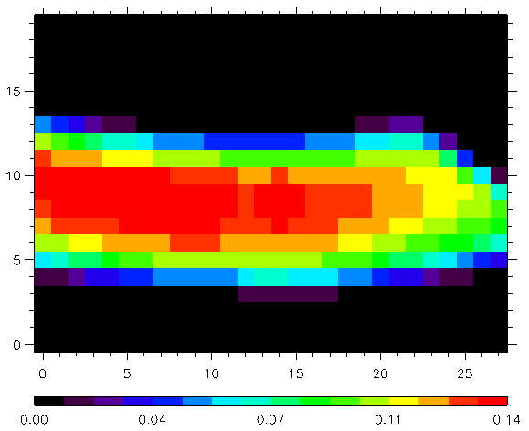
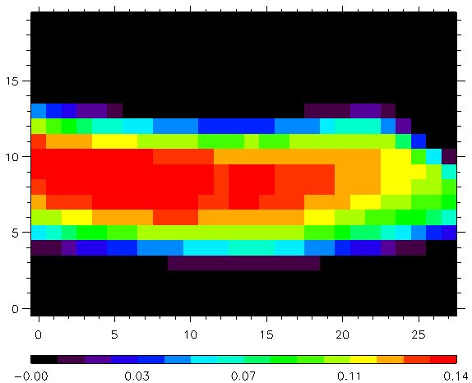
Reconstructed image by SVD (from special profile)
Radiation profile on poloidal cross section
(uniform)
Reconstructed by SVD
(uniform)
Incident radiation
(from EMC-3)
Incident radiation
(from reconstructed)
Radiation profile on poloidal cross section
(Collapse like)
Reconstructed by SVD
(Collapse like)
Incident radiation
(from reconstructed)
Incident radiation
(from EMC-3)
・Reconstructed radiation profile has tendency of original profile.
・More constraints or filter is required.

Slide 23
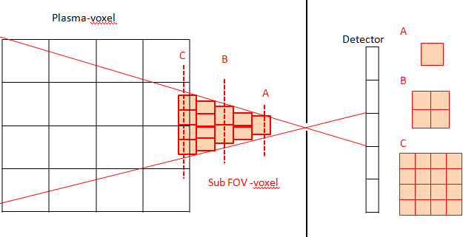
IRVB signal and geometry matrix calculation
Absorbed power at each detector channel
P_{rad,j} :Absorbed power on each detector
h_{j,k} :The geometry matrix as a projection matrix
S_{k} :The radiation intensity from the plasma-voxel
j :Index of detector channel
K :index of plasma-voxel
Geometry matrix (projection matrix)
h_{j,k} : The geometry matrix as a projection matrix
V_{i,j,k} : Volume of FOV(field of view) sub-voxel
Ω_{i,j,k} : solid angle of the detector with respect to the sub
FOV sub-volume
k : Index of plasma-voxel
i : Index of FOV sub-volume
j : Index of detector channel

Slide 24
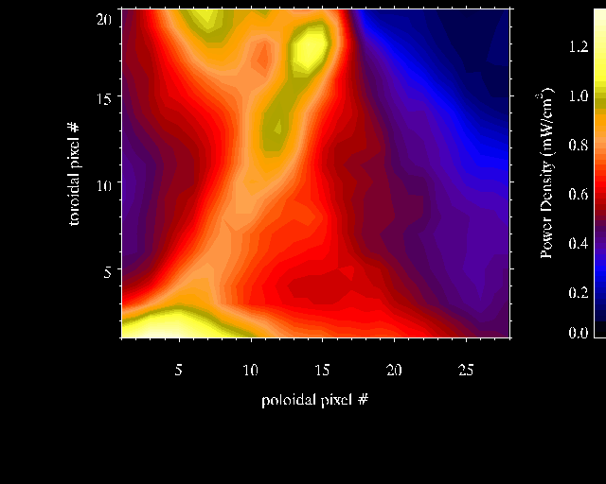
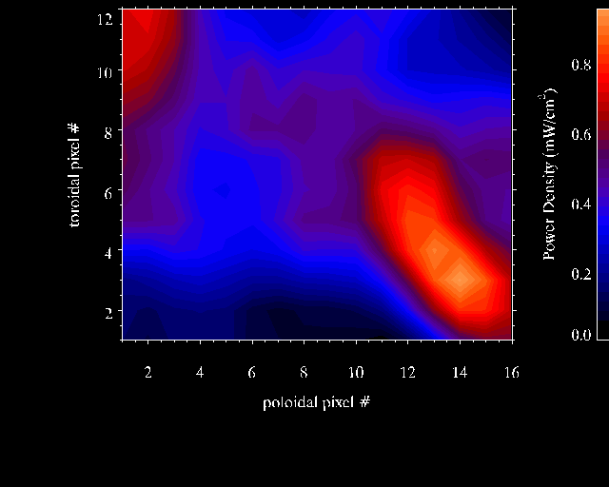
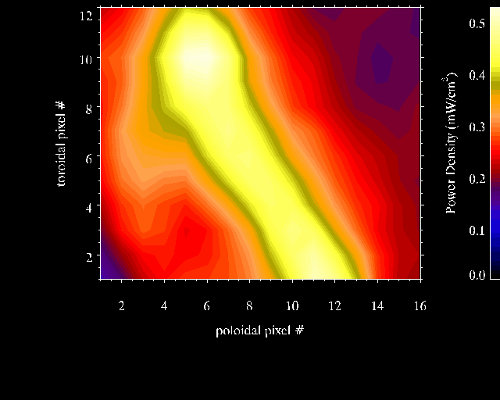
IRVBs can take spatial and temporal radiation changes

