Slide 1

第18回若手科学者によるプラズマ研究会
2015/03/04-06
SOL-Divertor Plasma Simulations by Introducing Anisotropic Ion Temperatures and Virtual Divertor Model
非等方イオン温度と仮想ダイバータモデルを導入したSOL-ダイバータプラズマシミュレーション
Satoshi Togo, Tomonori Takizukaª, Makoto Nakamura^{b},
Kazuo Hoshino^{b}, Kenzo Ibanoª, Tee Long Lang, Yuichi Ogawa
Graduate School of Frontier Sciences, University of Tokyo, 5-1-5 Kashiwanoha, Kashiwa 277-8568, Japan
ªGraduate school of Engineering, Osaka University, 2-1 Yamadaoka, Suita 565-0871, Japan
^{b}Japan Atomic Energy Agency, 2-166 Omotedate, Obuchi-aza, O-aza, Rokkasho 039-3212, Japan

Slide 2
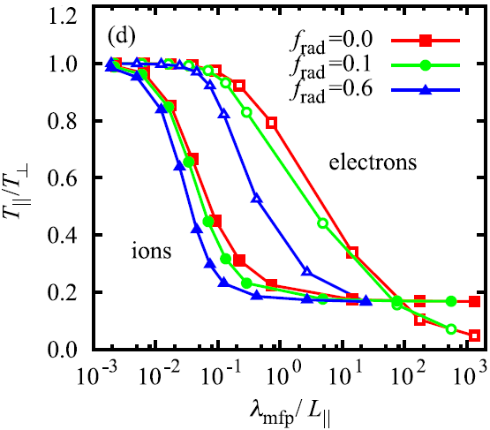
Motivation
The SOL-divertor plasma code packages (SOLPS, SONIC, etc.)
・used to estimate the performance of the divertors of future devices
・some physics models are used in the plasma fluid model (e. g. viscosity)
・physics models are valid in the collisional regime
Result from PARASOL code
parallel momentum transport equation (1D)
The parallel ion viscous flux -η_{i,//}(∂V/∂s)
・the approximated form of the stress tensor π
(π = 2n(T_{i,//} - T_{i,⊥})/3)
・derived under the assumption that π << nT_{i}.
The kinetic simulations showed a remarkable anisotropy in the ion temperature even for the medium collisionality.
collisional
collisionless
A. Froese et al., Plasma Fusion Res. 5 (2010) 026.
The boundary condition M_{t} = 1 has been used in the conventional codes.
However, the Bohm condition only imposes the lower limit as M_{t} ≥ 1.

Slide 3
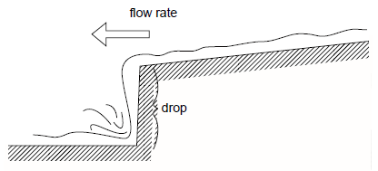
Momentum Eq. & Virtual Divertor Model
Introduction of the anisotropic ion temperatures, T_{i,//} and T_{i,⊥}, to the fluid model
・changes the momentum transport equation into the first-order
・makes the explicit boundary condition at the divertor plate unnecessary
Parallel-to-B component of the Boltzmann equation
(isotropic T_{e} is assumed)
conventional codes (effective isotropic T_{i})
Instead of the boundary condition M_{t} = 1, we modeled the effects of the divertor plate and the accompanying sheath by using a virtual divertor (VD) model.
Flow velocity is not determined by downstream ‘waterfall’ but by upstream condition.
P. C. Stangeby, The Plasma Boundary of Magnetic Fusion Devices.

Slide 4
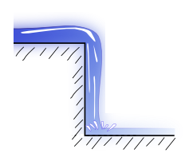
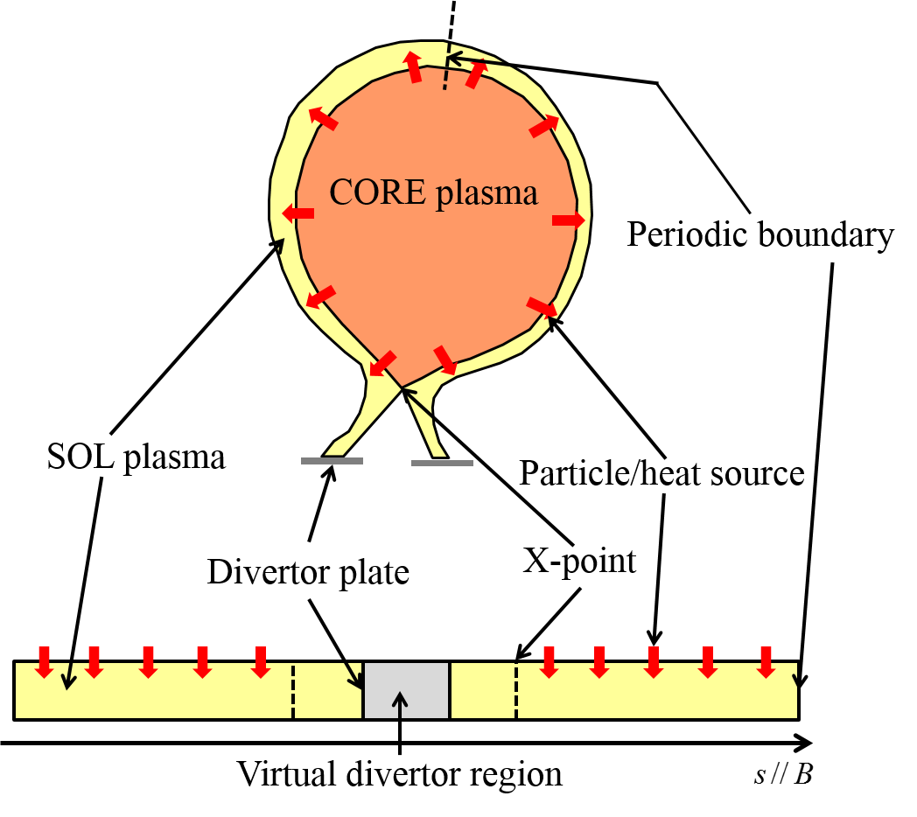
Plasma Fluid Eqs. & Artificial Sinks in VD
Eq. of continuity
Artificial sinks in the virtual divertor (VD) region
Eq. of momentum transport
Eq. of parallel (//) ion energy transport
※according to the image of a waterfall
Periodic boundary condition
Eq. of perpendicular (⊥) ion energy transport
Eq. of electron energy transport
S. Togo et al., J. Nucl. Mater. (2015) in Press.

Slide 5
Plasma Fluid Eqs. & Artificial Sinks in VD
Eq. of continuity
Because the parallel internal energy convection is 3 times as large as the parallel internal energy, T_{i,//} becomes lower than T_{i,⊥}.
Eq. of momentum transport
Ion pressure relaxation time τ_{rlx} = 2.5τ_{i}.
(E. Zawaideh et al., Phys. Fluids 29 (1986) 463.)
Eq. of parallel (//) ion energy transport
Heat flux limiting factors;
α_{i,//} = α_{i,⊥} = 0.5, α_{e} = 0.2
are used.
q_{σ}^{eff} = (1/q_{σ}^{SH} + 1/α_{σ}q_{σ}^{FS})⁻¹
c = 0.5 is used.
Eq. of perpendicular (⊥) ion energy transport
Eq. of electron energy transport
Neutral is not considered at first.

Slide 6
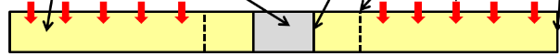
Results (Anisotropy of T_{i} and the Profiles)
Anisotropy of T_{i} vs normalized MFP of i-i collision
VD
n (10¹⁹ /m³)
collisional case
M
weakly collisional case
T_{i,//} (eV)
T_{i,⊥} (eV)
T_{e} (eV)
Γ_{sep} and P_{sep} are changed.

Slide 7
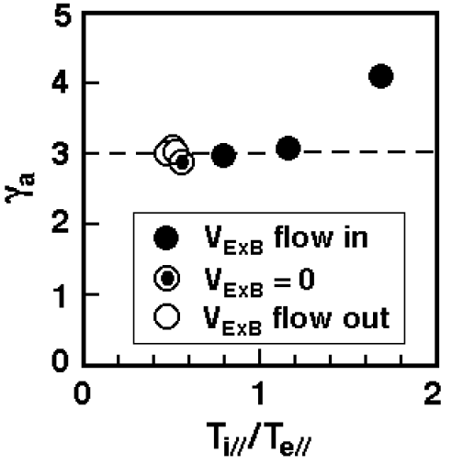
Results (Bohm condition M* = 1)
Time evolutions of M* for various τ^{VD}
γ_{a} = 3 for adiabatic, collisionless sound speed
PARASOL
T. Takizuka and M. Hosokawa, Contrib. Plasma Phys. 40 (2000) 3-4, 471.
M* saturates at ~ 1 independently of the value of τ^{VD}.
Characteristic time τ_{Bohm} depends on τ^{VD} and 2 orders shorter than the quasi-stationary time ~ 10⁻³ s.
For the simulations of transient phenomena, such as ELMs, τ_{Bohm} has to be smaller than their characteristic times.

Slide 8
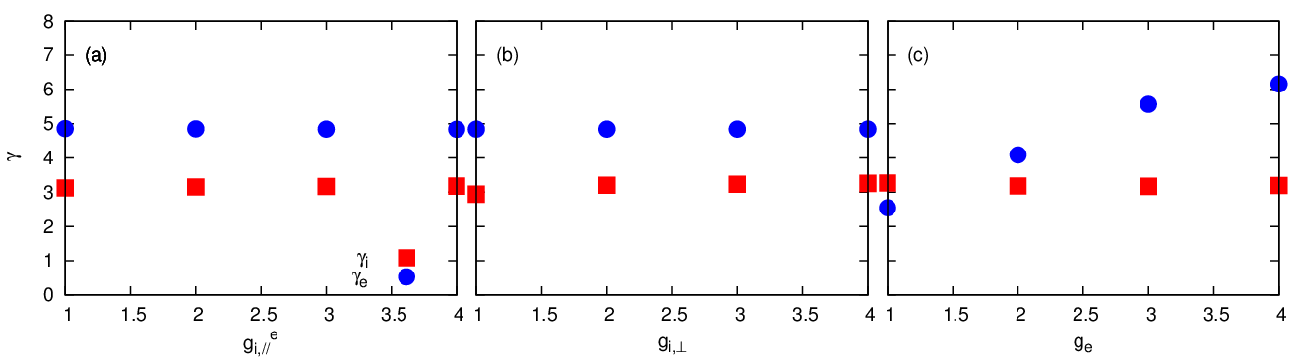
Results (Sheath heat transmission factors)
Boundary conditions for the heat flux at the divertor plate in the conventional codes;
From the sheath theory,
For T_{i} = T_{e},
γ_{e} ≈ 5 for H⁺ plasma
γ_{e} ≈ 5.3 for D⁺ plasma
Relation between sheath heat transmission factors and g_{σ}
γ_{i} scarcely depends on g_{σ} because convective heat flux dominates conductive one.
γ_{e} can be adjusted to the values based on the sheath theory by VD model.

Slide 9
Results (Dependence of the profiles on τ^{VD})
Decay length in VD region: L_{d} ~ V_{t}τ^{VD}.
As long as Δs < L_{d} < L^{VD}, the profiles in the plasma region do not change.
If L_{d} > L^{VD} (when τ^{VD} = 5×10⁻⁵ s in figure), the profiles become invalid.
If L_{d} < Δs, numerical calculation diverges.
The profiles just in front of the divertor plates are affected by the artificial sinks in VD region due to numerical viscosity.
This problem will be solved by introducing a high-accuracy difference scheme and an inhomogeneous grid.

Slide 10
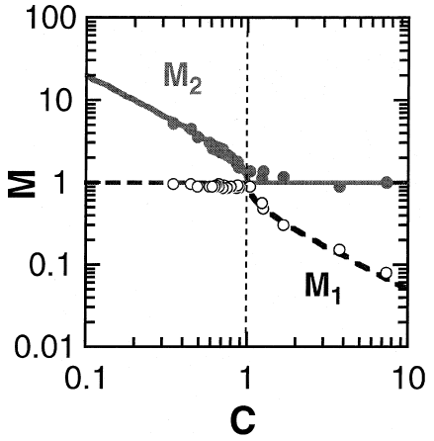
Results (Supersonic flow due to cooling)
C = (R_{Γ}/R_{p})(T_{t}/T_{X})^{1/2}, T = T_{i,//} + T_{e(,//)}
M = V/c_{s}
Isothermal sound speed
PARASOL
(at the plate)
Cooling term Q_{e} = -nT_{e}/τ_{rad} is set in the divertor region.
R_{Γ} = R_{p} = 1
M_{t} well agrees with the theory.
The reason for M_{X} > 1 is under investigation.
(at the X-point)
T. Takizuka et al., J. Nucl. Mater. 290-293 (2001) 753.

Slide 11
Results (Ion Viscous Flux vs Stress Tensor)
Two kinds of ion viscous flux,
are compared to the stress tensor,
π^{def} = 2n(T_{i,//}-T_{i,⊥})/3, in the particle-source-less-region (s = 20.005 m) and particle-source-region (s = 17.005 m).
π^{BR} becomes 2~3 orders larger than π^{def} as λ_{mfp}/L becomes large.
β = 0.7 :viscosity limiting factor
In the particle-source-region, the correlation between π^{lim} and π^{def} becomes worse especially in the collisional region.
In the particle-source-less region, π^{lim} with β = 0.7 comparably agrees with π^{def}. However, β depends on the anisotropy of ion pressure which might change with the neutral effects.
Therefore, it is necessary to distinguish between T_{i,//} and T_{i,⊥}.

Slide 12
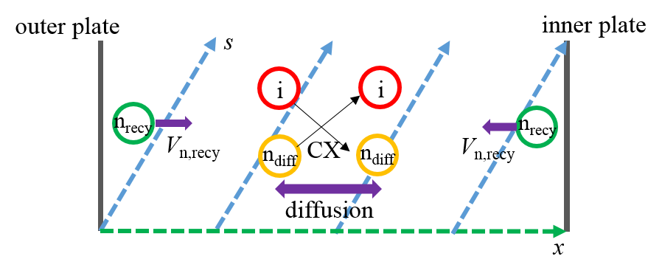
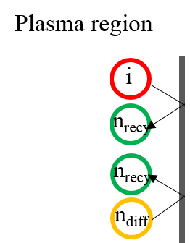
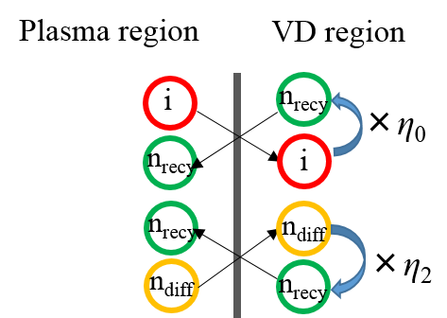
Self-Consistent Neutral Model (in VD)
conventional
present
Recycling neutral
Diffusion neutral
The coordinate x
: poloidal direction x = (B_{p}/B)s.
boundary condition
periodic boundary condition
Recycling neutral (inner plate)
Recycling neutral (outer plate)
(Eq. of continuity for plasma)
Diffusion neutral
τ_{n,diff}^{VD} : input

Slide 13
Self-Consistent Neutral Model (in Plasma)
Recycling neutral (inner plate)
Recycling neutral (outer plate)
where V_{FC} = (2ε_{FC}/m_{i})^{1/2} with Franck-Condon energy ε_{FC} = 3.5 eV.
Diffusion neutral
α_{L} : input
T. Takizuka et al., 12th BPSI Meeting, Kasuga, Fukuoka 2014 (2015).
The coordinate x: poloidal direction x = (B_{p}/B)s.

Slide 14
Atomic Processes
Recycling neutral (inner plate)
Recycling neutral (outer plate)
Diffusion neutral
Source terms for plasma:
(θ = B_{p}/B)
(ε_{iz} = 30 eV)
(T_{i} = (T_{i,//} + 2T_{i,⊥})/3)

Slide 15
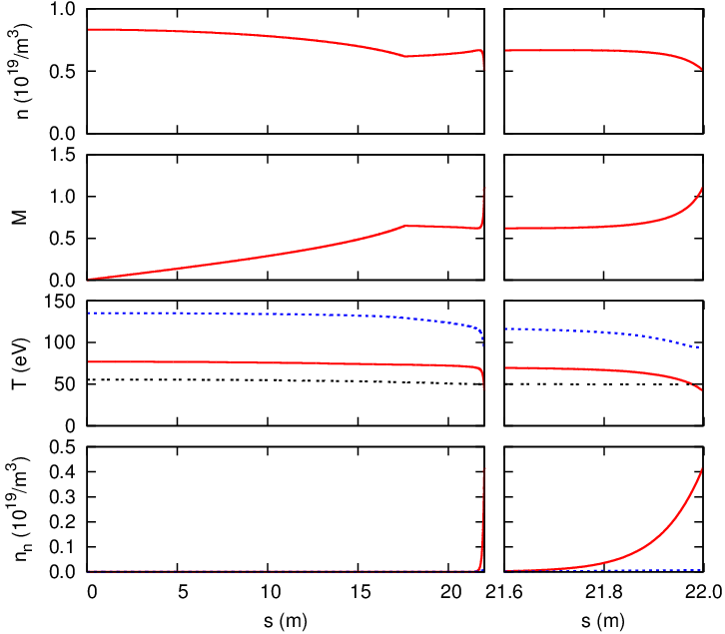
Result (Low recycling condition)
X-point
Near the plate
α_{L} = 1
Recycling rate ~ 0.17
T_{i,//}/T_{i,⊥} ~ 0.6
Recycling neutral dominant
T_{i,⊥}
T_{i,//}
T_{e}
n_{n,recy}
n_{n,diff}

Slide 16
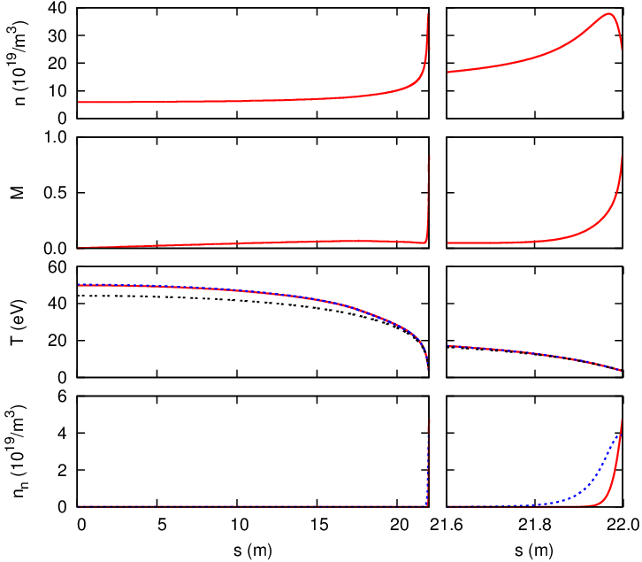
Result (High recycling condition)
X-point
Near the plate
α_{L} = 0.1
Recycling rate ~ 0.92
T_{i,//}/T_{i,⊥} ~ 1
Diffusion neutral dominant
T_{i,//}
T_{i,⊥}
T_{e}
n_{n,diff}
n_{n,recy}

Slide 17
Conclusions
1D SOL-divertor plasma model with anisotropic ion temperatures has been developed. In order to express the effects of the divertor plate and the accompanying sheath, we use a virtual divertor (VD) model which sets artificial sinks for particle, momentum and energy in the additional region beyond the divertor plate. In addition, VD makes the periodic boundary condition available and reduces the numerical difficulty.
For simplicity, the symmetric inner/outer SOL-divertor plasmas with the homogeneous magnetic fields are assumed. In order to simulate more general asymmetric plasmas with the inhomogeneous magnetic fields, the effects of the plasma current and the mirror force have to be considered. In addition, it is necessary to introduce a high-accuracy difference scheme and an inhomogeneous grid in order to avoid the numerical errors at the divertor plate. These are our future works.

Slide 18
D_{m}^{VD} & g_{i,//} in VD region
D_{m}^{VD} and g_{i,//} in VD region have Gaussian shapes.
The length of V-connection-region L₀ = 1.6 m.

Slide 19
Results (Bohm condition)
Mach profiles for various Δs
γ_{a} = 3 for adiabatic, collisionless sound speed
M* ≈ 1 with no cooling effects.
Plasma
VD
The effect of artificial sinks in VD region numerically diffuses in the plasma region.
T. Takizuka and M. Hosokawa, Contrib. Plasma Phys. 40 (2000) 3-4, 471.

Slide 20
Appendix ~ Collisionless Adiabatic Flow ~
1D equations in the collisionless limit;
Refer to Sec 10.8 of Stangeby’s text

Slide 21
The effect of g_{σ} on γ_{t} (heat transmission factor)
The boundary condition for the heat flux at the divertor plate in the usual codes;
The heat transmission factors, γ_{i} and γ_{e}, are input parameters.
The VD model, however, does not use this boundary condition but the periodic boundary condition with the cooling index g_{σ} (σ ∈ i//, i⊥, e). Therefore γ_{i} and γ_{e} are back calculated using these relations.
The conduction heat fluxes are limited by the free-streaming heat fluxes with limiting coefficients α_{σ} as q_{σ}^{eff} = (1/q_{σ}^{SH} + 1/α_{σ}q_{σ}^{FS})⁻¹.
Thus the effective conduction heat fluxes are smaller than the free-streaming heat fluxes times limiting coefficients α_{σ}q_{σ}^{FS} so that γ_{t} has the maximum.

Slide 22
Calculation condition
Calculation condition
H plasma and n_{i} = n_{e} = n
Symmetric inner/outer SOL
Length of the plasma L | 44 m
SOL width d | 2 cm
Separatrix area | 40 m²
Particle flux from core Γ_{sep} | 1~5×10²² /s
Heat flux from the core P_{sep} | 1~4 MW
Cooling index for i,// | 1
Cooling index for i,⊥ | 1.2
Cooling index for e | 2.5
τ^{VD} | 5×10⁻⁶ s
Heat flux limiter for ion | 0.5
Heat flux limiter for electron | 0.2

Slide 23
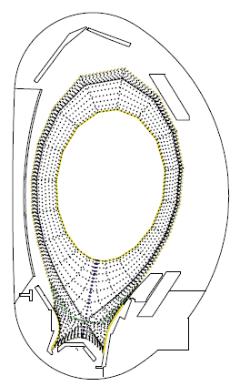
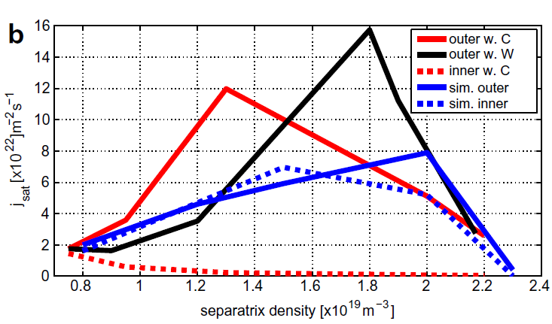
Discrepancy
Edge transport code packages, such as SOLPS and SONIC, are widely used to predict performance of the scrape-off layer (SOL) and divertor of ITER and DEMO. Simulation results, however, have not satisfactorily agreed with experimental ones.
Comparison of results (EXP vs SIM)
M. Wischmeier et al., J. Nucl. Mater. 390-391, 250 (2009).

Slide 24
Why does T_{i,//} become lower than T_{i,⊥}?
Reduced eq. of parallel (//) ion energy transport
Integration over x from the stagnation to x yields,
Reduced eq. of perpendicular (⊥) ion energy transport
By considering the kinetic energy term and force term, T_{i,//}/T_{i.⊥} ~ 0.2.
Eq. of parallel (//) ion energy transport

Slide 25
Qualitative derivation of the viscous flux
Simplified system equations
Assumption of π << nT_{i}
(A)
(E)’
(B)
(B)’
(C)
(D)
By (A) and (B)’, LHS of (E)’ becomes
From (C) – (D)
Then
(E)

Slide 26
Necessity of artificial viscosity term
artificial viscosity term
conservation of ion particles
conservation of parallel plasma momentum
When V is positive, RHS becomes positive. If V becomes supersonic, dV/dx becomes positive and V cannot connects.

Slide 27
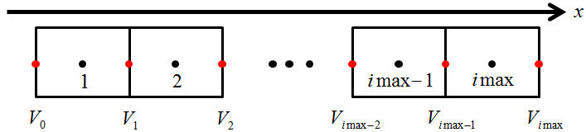
Discretization
discretization scheme
general conservation equation
full implicit
upwind
central
staggered mesh (uniform dx)

Slide 28
Calculation method
matrix equation
(ex. N = 5)
Matrix G becomes cyclic tridiagonal due to the periodic boundary condition. This matrix can be decomposed by defining two vectors u and v so that
where A is tridiagonal.

Slide 29
Calculation method
Sherman-Morrison formula
where and .
y and z can be solved by using tridiagonal matrix algorithm (TDMA).
calculation flow
No
Ion // energy
Ion ⊥ energy
Elec. energy
Momentum
Particle
Yes
The number of equations can be changed easily.

Slide 30
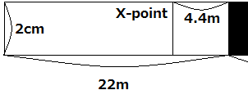
Continuity of Mach number
conservation of ion particles
conservation of parallel plasma momentum
O. Marchuk and M. Z. Tokar, J. Comput. Phys. 227, 1597 (2007).
Due to the continuity of Mach number, RHS has to be zero at the sonic transition point (M = 1).
RHS > 0
RHS ≦ 0
Sonic transition has to occur at the X-point when T = const.

Slide 31
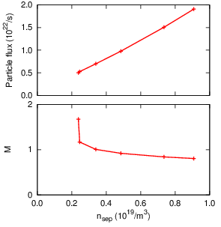
Result (particle flux & Mach vs n_{sep})
Γ_{t} ∝ n_{sep}
→ accords with conventional simulations
Supersonic flow (M_{t} > 1)
→ observed when n_{sep} is low
Subsonic flow (M_{t} < 1)
→ observed when n_{sep} is high
→ numerical problem?
Larger n_{sep} (like detached plasmas) is future work.

Slide 32
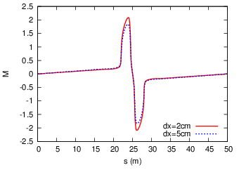
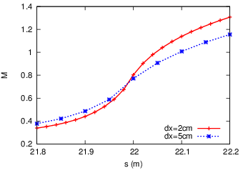
Result (Mach number near the plate)
Near the plate
Plasma
VD
Δs = 5cm
Δs = 2cm
M > 1 is satisfied in the near-plate VD region.
Smaller Δs results in a better result. → Numerical problem?

Slide 33
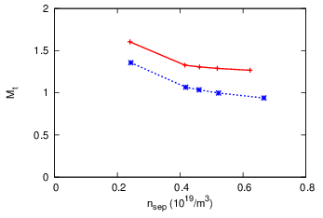
Result (M_{t} vs n_{sep})
The recycling neutrals are not ionized or do not experience the charge exchange near the plate (red line).

